Slide 1

Joint Committee on Communications, Climate Action and Environment
30 January 2018
Analysis of Climate Policy Developments
Cliona Sharkey, Trócaire;
Oisín Coghlan, Friends of the Earth
Notes:
Climate Action Progress Update
1. National Climate Dialogue – Opening Up The National Power Grid To Community And
Non Profit, Renewable Energy Providers.
2. Ireland’s Emissions Targets As Set By The European Union In The Context Of The Paris
Agreement.
3. National Mitigation Plan

Slide 2
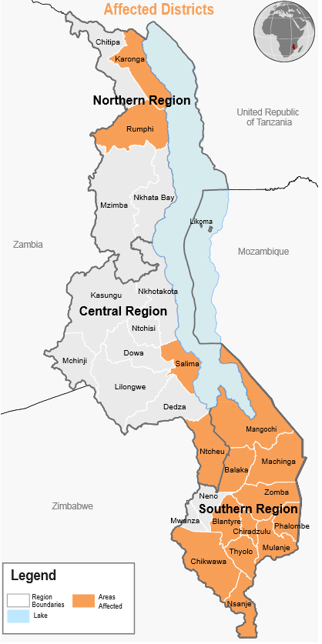
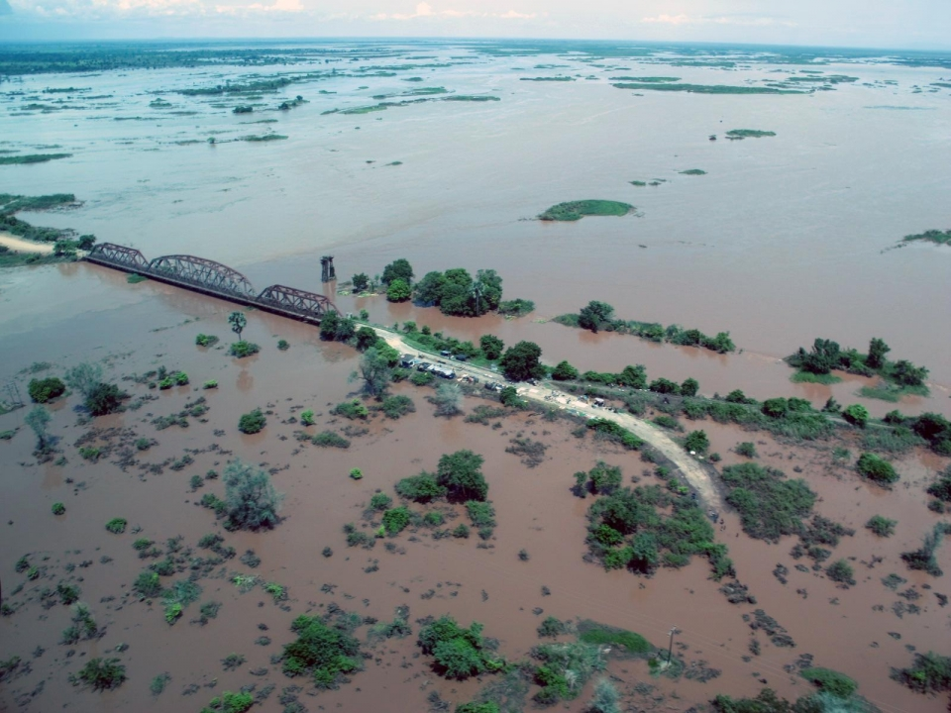
Climate Impacts today – already hitting the poorest countries hardest
A third of Malawi was declared a National Disaster Zone in late 2015/early 2016 due to major flooding.

Slide 3
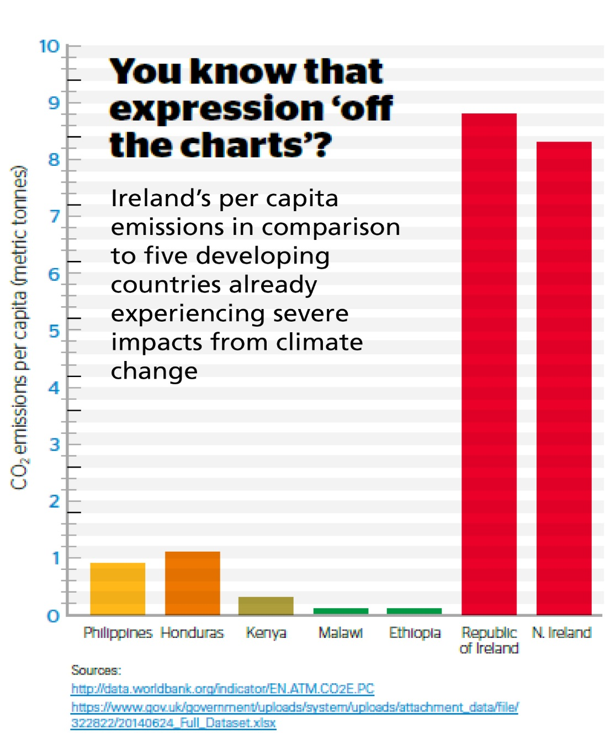
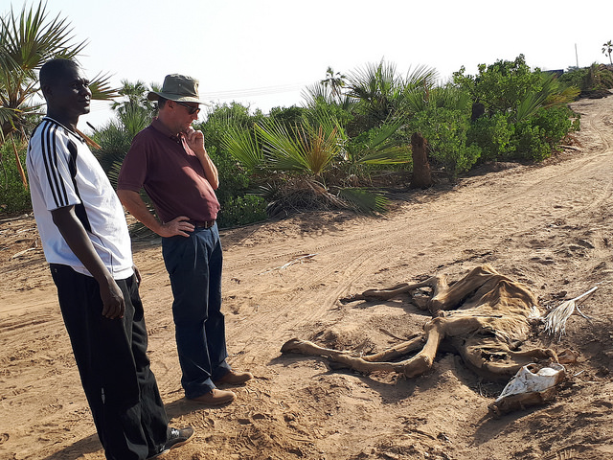
Climate Impacts today – already hitting the poorest countries hardest
Livestock succumbing to drought in Turkana, Kenya. May 2017. Persistent drought continues to leave millions struggling in East Africa.

Slide 4
More than an environmental issue – a systemic risk
- In 2015 alone, more than19.2 million people across 113 countries fled climate-related disasters. Norwegian Refugee Council (2016) ‘Disaster and Climate Change’.
- Climate change and directly connected issues of extreme weather have consistently featured among the top 10 risks ranked in the World Economic Forum Global Risks Report since 2011.
- A report by an Advisory Committee to the European Systemic Risk Board in 2016 highlighted that ‘a late transition to a low-carbon economy would exacerbate the physical costs of climate change’, risking, ‘a hard landing, constraining energy supply, increasing whole economy production costs, with effects equivalent to a large and persistent negative economic shock’. ‘Too Late, Too Sudden’. Scientific Advisory Committee to European Systemic Risk Board. (2016)
‘The need to manage emerging, mega risks is as important as ever. Alongside major technological, demographic and political shifts, our very world is changing. Shifts in our climate bring potentially profound implications for insurers, financial stability and the economy’. Governor of the Bank of England, Mark Carney, speaking at Lloyds of London, 2015.
Europe, including Ireland, is also vulnerable to spill-over effects from climate change impacts occurring elsewhere, including trade, infrastructure, transport, security risks, geopolitics, human migration and finance. European Environment Agency (2016). ‘Climate change, impacts and vulnerability in Europe 2016’.
Climate change resulted in 85,000 additional deaths in Europe over the period 1980-2013. European Environment Agency (2016). ‘Climate change, impacts and vulnerability in Europe 2016’.

Slide 5
The 2015 Paris Climate Agreement
All countries must
hold increase in temperatures to well below 2 °C and pursue efforts to limit increase to 1.5 °C.
communicate new more ambitious pledges every 5 years
take stock of efforts in 2018 & update current pledges by 2020.
But as of now
No country’s existing climate action plan, emissions targets or pledges are yet compatible with the Paris temperature goals.
Ireland and the EU’s targets for 2020, 2030 and 2050 will have to be ratcheted up
Notes:
Countries agreed two years ago in Paris that there should be a one-off moment in 2018 to “take stock” of how climate action was progressing. This information will be used to inform the next round of NDCs, due in 2020.
The final “approach” of the Talanoa dialogue was included as a four-page Annex to the main COP23 outcome decision.
It will be structured around three questions – “Where are we? Where do we want to go? How do we get there?” – but also includes new details, such as a decision to accept inputs from non-party stakeholders as well as parties, a decision to set up an online platform to receive inputs, and a new emphasis on efforts being made in the pre-2020 period.

Slide 6
Ireland is a drag on EU ambition
Ireland’s negotiation approach has actively hindered greater EU ambition to achieve Paris Agreement - Major reputational damage
EU 2030 Effort Sharing Regulation (transport, buildings, agriculture and waste)
Primary focus on securing loopholes and offsets
Negative impact on overall EU ambition
A10% additional reduction in emissions to just 1%
EU Renewable Energy Directive
Government proposed 2030 target no higher than 2020 target
EP - 35% renewables target and no binding national targets.
Still short of Paris Agreement ambition
Notes:
effortsharing.org - Ireland scores 13 points and ranks 18th as it advocates for weakening the starting point by setting it significantly above actual emissions and above its 2020 target. The country is furthermore not planning to go beyond its domestic 2030 target of 30% emission reductions nor has it set an adequate long-term target. The Commission proposal would already allow Ireland to stall its efforts to cut emissions, but the country is trying to weaken this proposal even further.

Slide 7
Ireland’s emissions are going the wrong way
Environmental Protection Agency
- Ireland’s emissions have risen more than 7% in two years.
- 2016 increased by 3.5 % - all sectors: Agriculture increased by 2.7%; Transport increased by 3.7%; Energy increased by 6.1%
- Significant increases expected to continue in agriculture and transport
- Steep challenges post-2020 without new policies
- Substantial non-compliances costs - €500million by 2020? €3-€6billion by 2030?
European Environment Agency
Ireland – 3rd highest producer of emissions per person in the EU
Part of small number of Member States set to miss 2020 targets (ESD).
Ireland only one of group where emissions predicted to continue to rise.
Notes:
- Analysis by the Department of Public Expenditure & Reform, and by UCC, has shown that without new, immediate and substantive efforts to cut emissions, Ireland faces financial penalties in the region of €500 million by 2020 for failing to comply with our EU climate and renewable energy commitments Analysis by the IIEA estimates that Ireland may face non-compliance costs of between €3bn and €6bn by 2030 for failing to reduce emissions unless further action is taken.

Slide 8
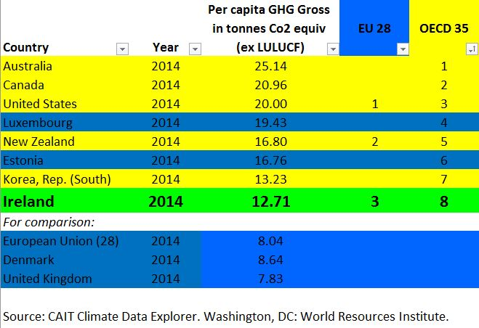
Per person, 8th highest in the rich world
Notes:
These are the latest figures from CAIT, the World Resources Institute’s Climate Data Explorer, one of the most trusted sources of climate data available. It is a free and open source for comprehensive and comparable climate and emissions data. http://cait.wri.org

Slide 9
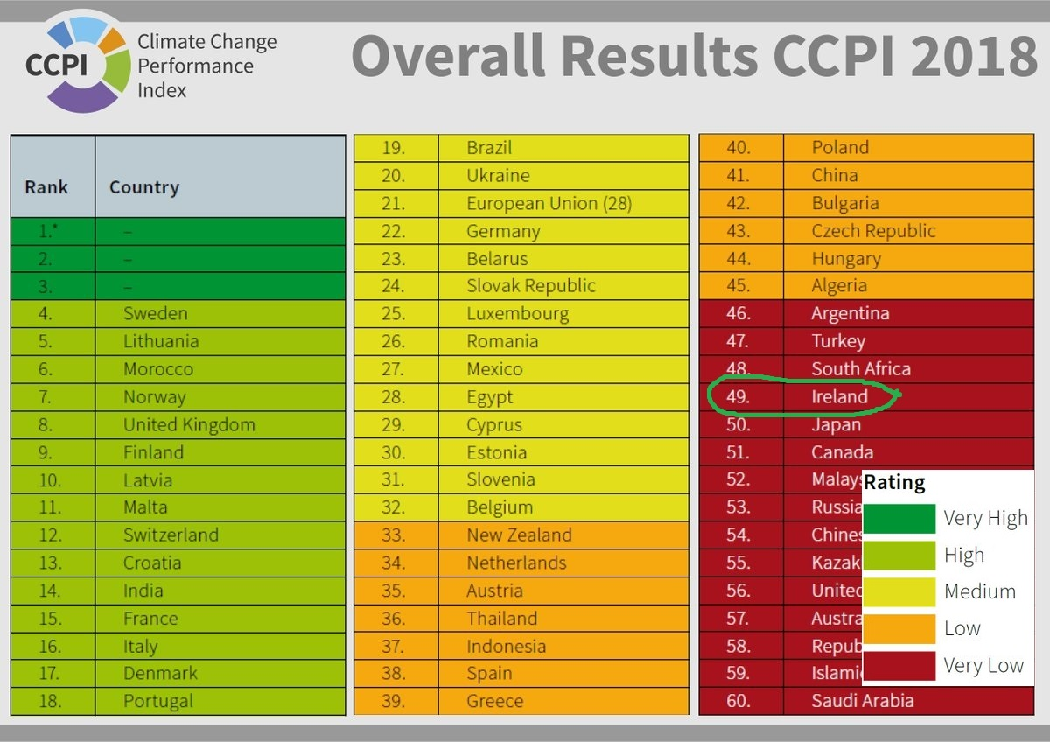
The worst performing country in Europe
Notes:
Ireland was ranked the worst performing country in Europe for action on climate change. The Climate Change Performance Index, which is produced annually on the basis of joint analysis by two leading European think-tanks, placed Ireland 49th out of 56 countries, a drop of 28 places from last year.
- Analysis by the Department of Public Expenditure & Reform, and by UCC, has shown that without new, immediate and substantive efforts to cut emissions, Ireland faces financial penalties in the region of €500 million by 2020 for failing to comply with our EU climate and renewable energy commitments Analysis by the IIEA estimates that Ireland may face non-compliance costs of between €3bn and €6bn by 2030 for failing to reduce emissions unless further action is taken.

Slide 10
National Mitigation Plan – Not fit for purpose
DPER memo, September 2017
‘"it would appear that almost no progress has been made on an appraisal-based, prioritised and integrated view of how to meet 2020 and 2030 climate targets’
NMP - clear on scale of challenge
Unclear on scale of risks and opportunities
More action promise than action plan
Listing of (some positive) climate-relevant initiatives
But no clear pathway to meeting key objectives

Slide 11
Advisory Council Annual Review, November 2017
‘There is an urgent requirement for new policies and measures, and action beyond what is committed to in the National Mitigation Plan if Ireland is to reduce emissions by 2020 and to move onto a sustainable path to 2050 to tackle climate change
EPA, November 2017
Achieving Ireland’s long-term decarbonisation objective can only take place with a transformation of our energy, agriculture and transport systems. We need to adopt a much greater sense of urgency about reducing our dependence on fossil fuels while radically improving energy efficiency. In relation to agriculture, Ireland must optimise agricultural production to ensure long term environmental integrity and sustainability. The growth in this sector, particularly for dairy and other cattle, points to very significant risks in relation to meeting our decarbonisation objectives

Slide 12
Budget did not deliver climate action
NMP promised the Budget and the Capital Plan would prioritize climate action
2018 Budget
€2 billion investment needed every year to 2030 for retrofitting homes.
2018 Budget only delivered an additional €38 million for energy savings schemes.
€7 million to incentivize renewable heat but scheme excludes community projects.
Road development €2.4 billion invested over four years
Only €35 million to support low-carbon projects and only €10million additional funding allocated to cycling and walking.
Upcoming 10-year Capital Investment Plan - a piecemeal or integrated approach?

Slide 13
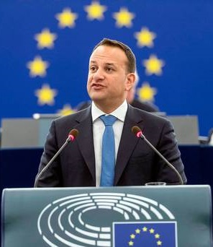
Laggard or Leader?
14 June 2017
“I am determined that the Government should show new ambition when it comes to tackling climate change”
Dáil Eireann
17 January 2018
“... as far as I am concerned, we are a laggard. I am not proud of Ireland’s performance on climate change.”
European Parliament

Slide 14
What needs to happen every year
The Climate Act establishes an annual policy cycle but too many loopholes.
This committee is central to ensuring parliamentary oversight and accountability.
The EPA, CCAC and a climate scientist should testify every January
All four ministers who deliver annual transition statements in December should come before the Committee in Q1
Before EU Councils discussing climate, Minister should lay out approach to Committee
DPER and DFin should lay out their approach to climate in the Budget in Q2
CCAC should produce its annual report well before Minister delivers transition statement.
Actual transition statement must be published before Dáil and Seanad statements (unlike 2017).

Slide 15
What needs to happen this year
This Committee should formally recommend to Minister Naughten that he immediately begin a process to revise the National Mitigation Plan.
The Oireachtas should start a process to consider the recommendations of the Citizens’ Assembly on climate as they did on the 8th Amendment:
A special all-party committee to report by end July?
The Capital Investment Plan must prioritize emissions from transport and buildings
Minister must deliver on his commitment that the new support schemes for renewables will deliver community ownership of renewables and a fair payment for smallscale rooftop solar power.
Budget 2019 is key opportunity to look and carbon tax and site value tax.

