Slide 1




How can Ireland rapidly decarbonise energy to meet carbon budgets? Ireland 2030 – Faster and Fairer Climate Action 22nd April, 2024
Prof. Hannah Daly, University College Cork
Notes:
We are all here today, on Earth Day, because we are concerned about the state of our precious planet. Human activities are changing planetary systems on a colossal scale, and its in our power to stop this, and even reverse most of the damage.
On the one hand, we in Ireland have come a long way. .
We have political commitments to decarbonisation, enshrined in carbon budgets.. Paris Agreement, we have stopped new licences for fossil fuels.
BUT targets have not translated into meaningful emissions reductions.
According to projections of greenhouse gases,
Ireland will breach legally-binding carbon budgets and international obligations
unless an urgent course correction is taken to align with these commitments.
The nature of this challenge is unprecendented, and we are not collectively treating this as a real emergency.
There are other reasons for inertia.
There are many reasons why we as individuals and institutions prefer the status quo, and resist change, even if that change is for the better. Some of those reasons are rational - there are evolutionary advantages to not rocking the boat - our state institutions are geared towards preserving a stable democracy.
If our society is like a massive steamer ship, there are fears that if we try to turn it too quickly, it will sink.
But we can, and must, go much faster. For me, a great source of hope is that we have solutions.
but WE HAVE TO ADDRESS THE SOURCES OF INERTIA
There are many sources – but Two of the main reasons, for me. are - firstly – we are being distracted by false solutions, and there is wide scale disinformation and misinformation about what solutions are necessary.
.. Shouldn't we really be thinking of nucelar? And electric vehicles aren't perfect, shouldn't we wait for hydrogen?
Our policymakers, politicians, citizens, businesses need confidence that the solutions that are being proposed are the right ones, and that they bring wider benefits.
And that brings me to the second source of inertia - it’s in our nature to see the cost of change. We are often blind to the cost of the status quo. But the cost of the status quo is HUGE.
So the main purpose of my talk is to outline the MOST CRITICAL measure needed to get Ireland off fossil fuels, and to show how this energy transition can bring wide scale benefits

Slide 2
No miracles necessary These 5 measures take us 90% of the way to our 2030 objective
1.
Wind, solar & grid
2.
Electrify transport
3.
Reduce car use
4.
Clean heat
5.
Decarbonise industry
34%
22%
10%
12%
10%
Share of 2030 emissions cuts in energy, CAP24
Notes:
This is a positive story.
No miracles are necessary: the vast
majority of emissions savings required in the energy system this decade come from a handful of measures.
Our country runs on energy, and 85% of our energy comes from fossil fuels. These cause around 60% of our GHG emissions and we must cut ff to zero as quickly as possible.
The most important measure to replace fossil fuels is to generate clean sources of energy, and the infrastructure to supply it.
1. Wind, solar & grid
Even though the power sector is relatively small in terms of emissions, It is the backbone of our energy transion. And accounts for over one third of emissions savings in energy, according to the climate action plan.
We must replace fossil fuels with clean electricity from wind turbines, on land and at sea, and solar panels, on fields and on roofs.
Investment in the power grid – distributed and long-terms energy storage, flexibility and connecting our power grid to others– is also needed.
Offshore wind will be available in the 2030s, and in the meantime,
Onshore wind capacity should double by 2030, but many barriers remain – speeding up & resourcing the planning system & grid connections is necessary
Electrify transport
Secondly, transport is a major consumer of fossil fuels.
EV adoption must accelerate, by removing barriers and offering greater incentives.
The higher upfront cost of EVs is generally offset by significant savings from using an EV.
But, Growth in fossil fuel car sales is still greater than growth in EVs; petrol & diesel use is not falling.
Policy options include regulating fossil fuelled car marketing, escalating motor taxes, rolling out rapid & neighbourhood public charging, zero emission city centres & used EV imports.
EVs can play an even greater role in the energy transition… store energy for a house and complement wind & solar
Policy should also be tackling the growing size and weight of new cars, which is making roads less safe and causing greater emissions.
.
3. Reduce unnecessary car use
Thirdly, to complement transport eleification, we have to cut unnecessary car use. Our society is now built around the need for most adults to own a car, c
Measures to cut car use include:
Making public transport more available accessible, affordable & reliable & accelerate delivery of major infrastructure,
Ensure new housing developments are dense & have public transport access,
Greatly expand park & ride,
Ensure sustainable school transport options – school buses & safe routes to schools for all,
Disincentivise urban & workplace parking – reward sustainable commuting instead,
Reallocate road space to sustainable transport & the urban realm.
.
4. Retrofit, heat pumps & district heat
High heat loss from buildings and fossil fuel dependence in buildings is linked to energy poverty, poor health, air pollution, high energy bills, low comfort, & high greenhouse gas emissions.
Providing clean and affordable heating and retrofitting the housing stock can address these problems simultaneously.
District heating networks can serve around half of buildings and be integrated with the electricity system with heat storage. Spatial heat plans and targeted policy interventions can capitalise on this opportunity.
5. Decarbonise industry
Most emissions from the industrial sector come from burning fossil fuels – mainly natural gas - to produce heat. Over half of these fuels can be replaced by electricity, including using heat pumps.
Bioenergy, including biogas, and hydrogen can replace fossil fuels used for high temperature heat, but resources are more constrained.
Significant energy savings can be achieved through efficiency measures, like heat recovery.
Support industry to explore new technological options for decarbonising cement
These five measures take us 90% to meeting our 2030 objective for the energy system.
This energy transition is happening globally, and can be summarised in 3 steps – a huge growth in clean, renewable electricity, and its infrastrucutre; electrify what we can – vehicles, boilers - and stop wasting energy.
These measures already available and apart from cement, have wide scale use. We cannot decarbonise energy quickly without taking those steps
I want to quickly address one major reason people reject these solutions – the environmental and social cost of mining for the materials that are required, to make batteries, solar panels etc. I share this concern, and I don’t think we can be complacent about ensuring these supply chains are cleaned up. But there are three factors that I don’t believe get wide scale appreciation. Firstly, the environmental cost has to be weighted against the enormous damage that is done by extracting, refining, transporting and burning fossil fuels. Secondly, once these materials are mined, they become a virtually permanent resource. Unlike fossil fuels, that have to be constantly extracted because they’re burned, the copper, lithium etc energy transition materials can be endlessly reused. Which means once this new energy system is built, we can reach a steady state and hopefully end the need for mining. And thirdly, there is a lot of evidence that fossil fuel interests are amplifying the negative aspects of these solutions to delay the transition.
So Our major focus must be to roll these quickly as possible, in a way that is fair and kind to the environment..
if we can do that, the prize is huge.

Slide 3
The status quo is hugely costly The energy transition brings multiple benefits
Safe climate
Security
Health, wellbeing & equality
Prosperity
Notes:
Firstly, we get to contribute to the global effort to halt climate change.
Decarbonisation
Decarbonisation is an imperative: National carbon budgets, EU Directives, and the Paris Agreement are all legally binding on Ireland.
Failing to cut emissions quickly in the short-term and overshooting carbon budgets will make it more difficult to meet obligations in the long run, requiring costly and uncertain carbon removal technologies, which are unlikely to bring the same benefits for energy security, nature and wellbeing.
Irish people are threatened by climate change: we need the world to take greater action. Even though Ireland’s emissions are small in a global context, we are the second highest per-capita emitter in Europe. By meeting our own decarbonisation targets we can advocate for stronger climate action globally, helping to protect ourselves and future generations.
As a high-emitting country with only and capacity, Ireland has a moral responsibility to act. Leadership and solidarity shown through the pandemic shows we have the capacity for acting for the greater good.
The prize of a liveable climate should be enough.
The reality is that even though climate damages are terrible, they impact people far away, and in future generations, people with no voice, and climate alone may not be the imputes many need to make changes.
But even without counting the damage from climate change, the status quo is already hugely costly, and our status quo biases mean we discount these.
Security
Around 90% of Ireland’s primary energy demand is imported, leaving us vulnerable to geopolitical disruption, both from oil and gas supply shocks, and price volatility.
Ireland is one of the most fossil fuel dependent countries in Europe. This is hugely costly, and was the main reason for hardship, inflation, energy poverty and economic damage experienced through the cost-of-living crisis. Energy credits for households cost the budget €1bn last year alone.
According to the Energy Security Review, energy security will mainly come about by reducing fossil fuel dependence with renewables and efficiency. Costly strategic LNG infrastructure may be necessary to secure natural gas supplies until fossil fuel dependence is ended – a costly insurance policy
Climate change itself is a profound systemic risk to national security.
Lowering energy demand & energy waste improves energy security & resilience and reduces dependence on supply chains and critical minerals.
Health, wellbeing & equality
Fossil fuel dependence causes ill health, inequity and hardship, which can be addressed though a transformation to a sustainable energy system.
Clean energy can cut air pollution, which causes >1000 premature deaths annually, heart disease and respiratory illness, including asthma. Air pollution is mainly caused by burning stuff - coal, peat and wood in homes and diesel in cars, trucks and boilers.
Retrofitted homes are warmer, drier, and more comfortable. Warmer homes improve wellness and health, especially for the elderly.
Walking and cycling measures increase exercise & wellness, reduce car dependence, bringing many health benefits.
Improved active and public transport enhances social equity by improving access, lowering dependence on cars & its associated cost
Financial & economic benefits
Addressing climate change and cutting fossil fuel dependence is essential for long-term prosperity. Imported fossil fuels cost Ireland €5-8 billion annually. Fossil fuel prices are volatile, which hurts homes & businesses financially.
Many energy transition measures have an high upfront cost – it will take a huge amount of capital investment to transform the energy system and build this infrastructure - but this new energy system will cost much less to run, once it’s built, reduce bills & bring financial savings in the long-term.
A cleaner energy system reduces healthcare costs.
Generating energy domestically is a huge economic opportunity, including for job creation. Irish industry can drive innovation, by manufacturing and provide services for a renewable and efficiency energy system.
Climate change is a major threat to prosperity and growth. Taking action to cut emissions as part of a global effort reduces this threat.
Ireland is at risk of being left behind the green transition, and suffering from reputational damage unless commitments are met. Active travel supports local businesses, increases property values and lowers infrastructure cost.

Slide 4

Realising the benefits
Accelerate clean energy
Cut fossil fuels
Manage energy demand
Notes:
Realising these benefits means raising climate action on the political agenda, because, time, not technology is our main challenge
Accelerating the deployment of the measures I mentioned. Rather than seeking new solutions to decarbonise energy, bringing forward the adoption of these measures that are already mainstream, are scalable and bring broader benefits is more effective for remaining within carbon budgets.
2. A focus on clean energy deployment alone is not enough, we also have to concentrate of cutting fossil fuels, and that starts with not investing any more into things that run on fossil fuels – it seems obvious, but is generally missing from the discussion. Carbon budgets constrain total fossil fuel use, starting with the highest carbon fuels, coal and peat, then oil and gas. Targeting decarbonisation measures to replace the most polluting fuels brings greater carbon savings. While natural gas is required in the short- term, mainly for electricity, its use must fall substantially by 2030 to meet carbon budgets.
3. Cutting energy demand alongside new technologies is necessary to meet carbon budgets and the EU Energy Efficiency Directive, as strong growth is outpacing and diluting gains from technological measures, like running up a down-moving escalator. Examples include data centres, the growing size of new cars, and dispersed settlement patterns, which drive greater car use.
Before I start to conclude, I want to briefly speak about agriculture. My focus is mainly on the energy transition. But even if the world cuts fossil fuels to zero tomorrow, a BAU approach for the global food system would mean a breach of the PA. Ireland has an enormously carbon intensive agriculture system, but beside the climate impact, The cost of the status quo is also very large. This sector cannot be ignored.

Slide 5
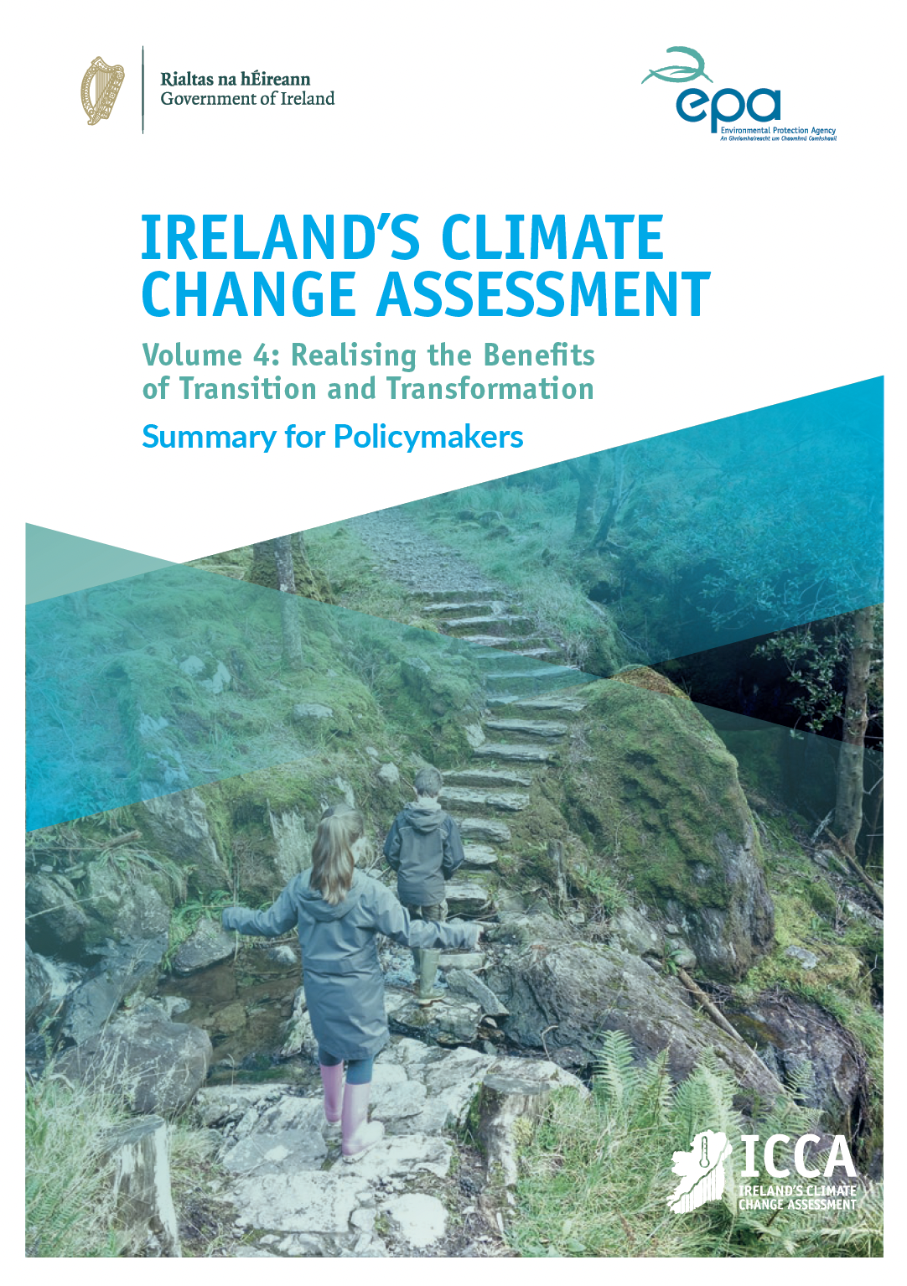

Transformative change
Transformative change is a fundamental, system wide reorganisation across technological, economic and social factors, including paradigms and goals, and valuing the climate, the environment, equity and wellbeing within decision making.
Notes:
Transformative changes are necessary to achieve the rapid, extensive emissions cuts. While these changes may be disruptive, if carefully
planned they can bring about many benefits across society.
I recently collaborated with other academics in Ireland’s climate change assessment report, funde by the EPA. We will present this report to the joint oireachtas committee on environment and climate action tomorrow
It provides a synthesis of what we know…
Transformative change
Policues need to treat climate and sustainability like public health
.. We now understand that one of the core functions of gvt is to preserve public health. This is not just through monetary policies - health tax - or scientific and engineering innivations - like medicine - but the view is embedded in all aspects of government, regulate advertising,
Protecting public health is also not a once-off measure. It requires constant management, …

Slide 6
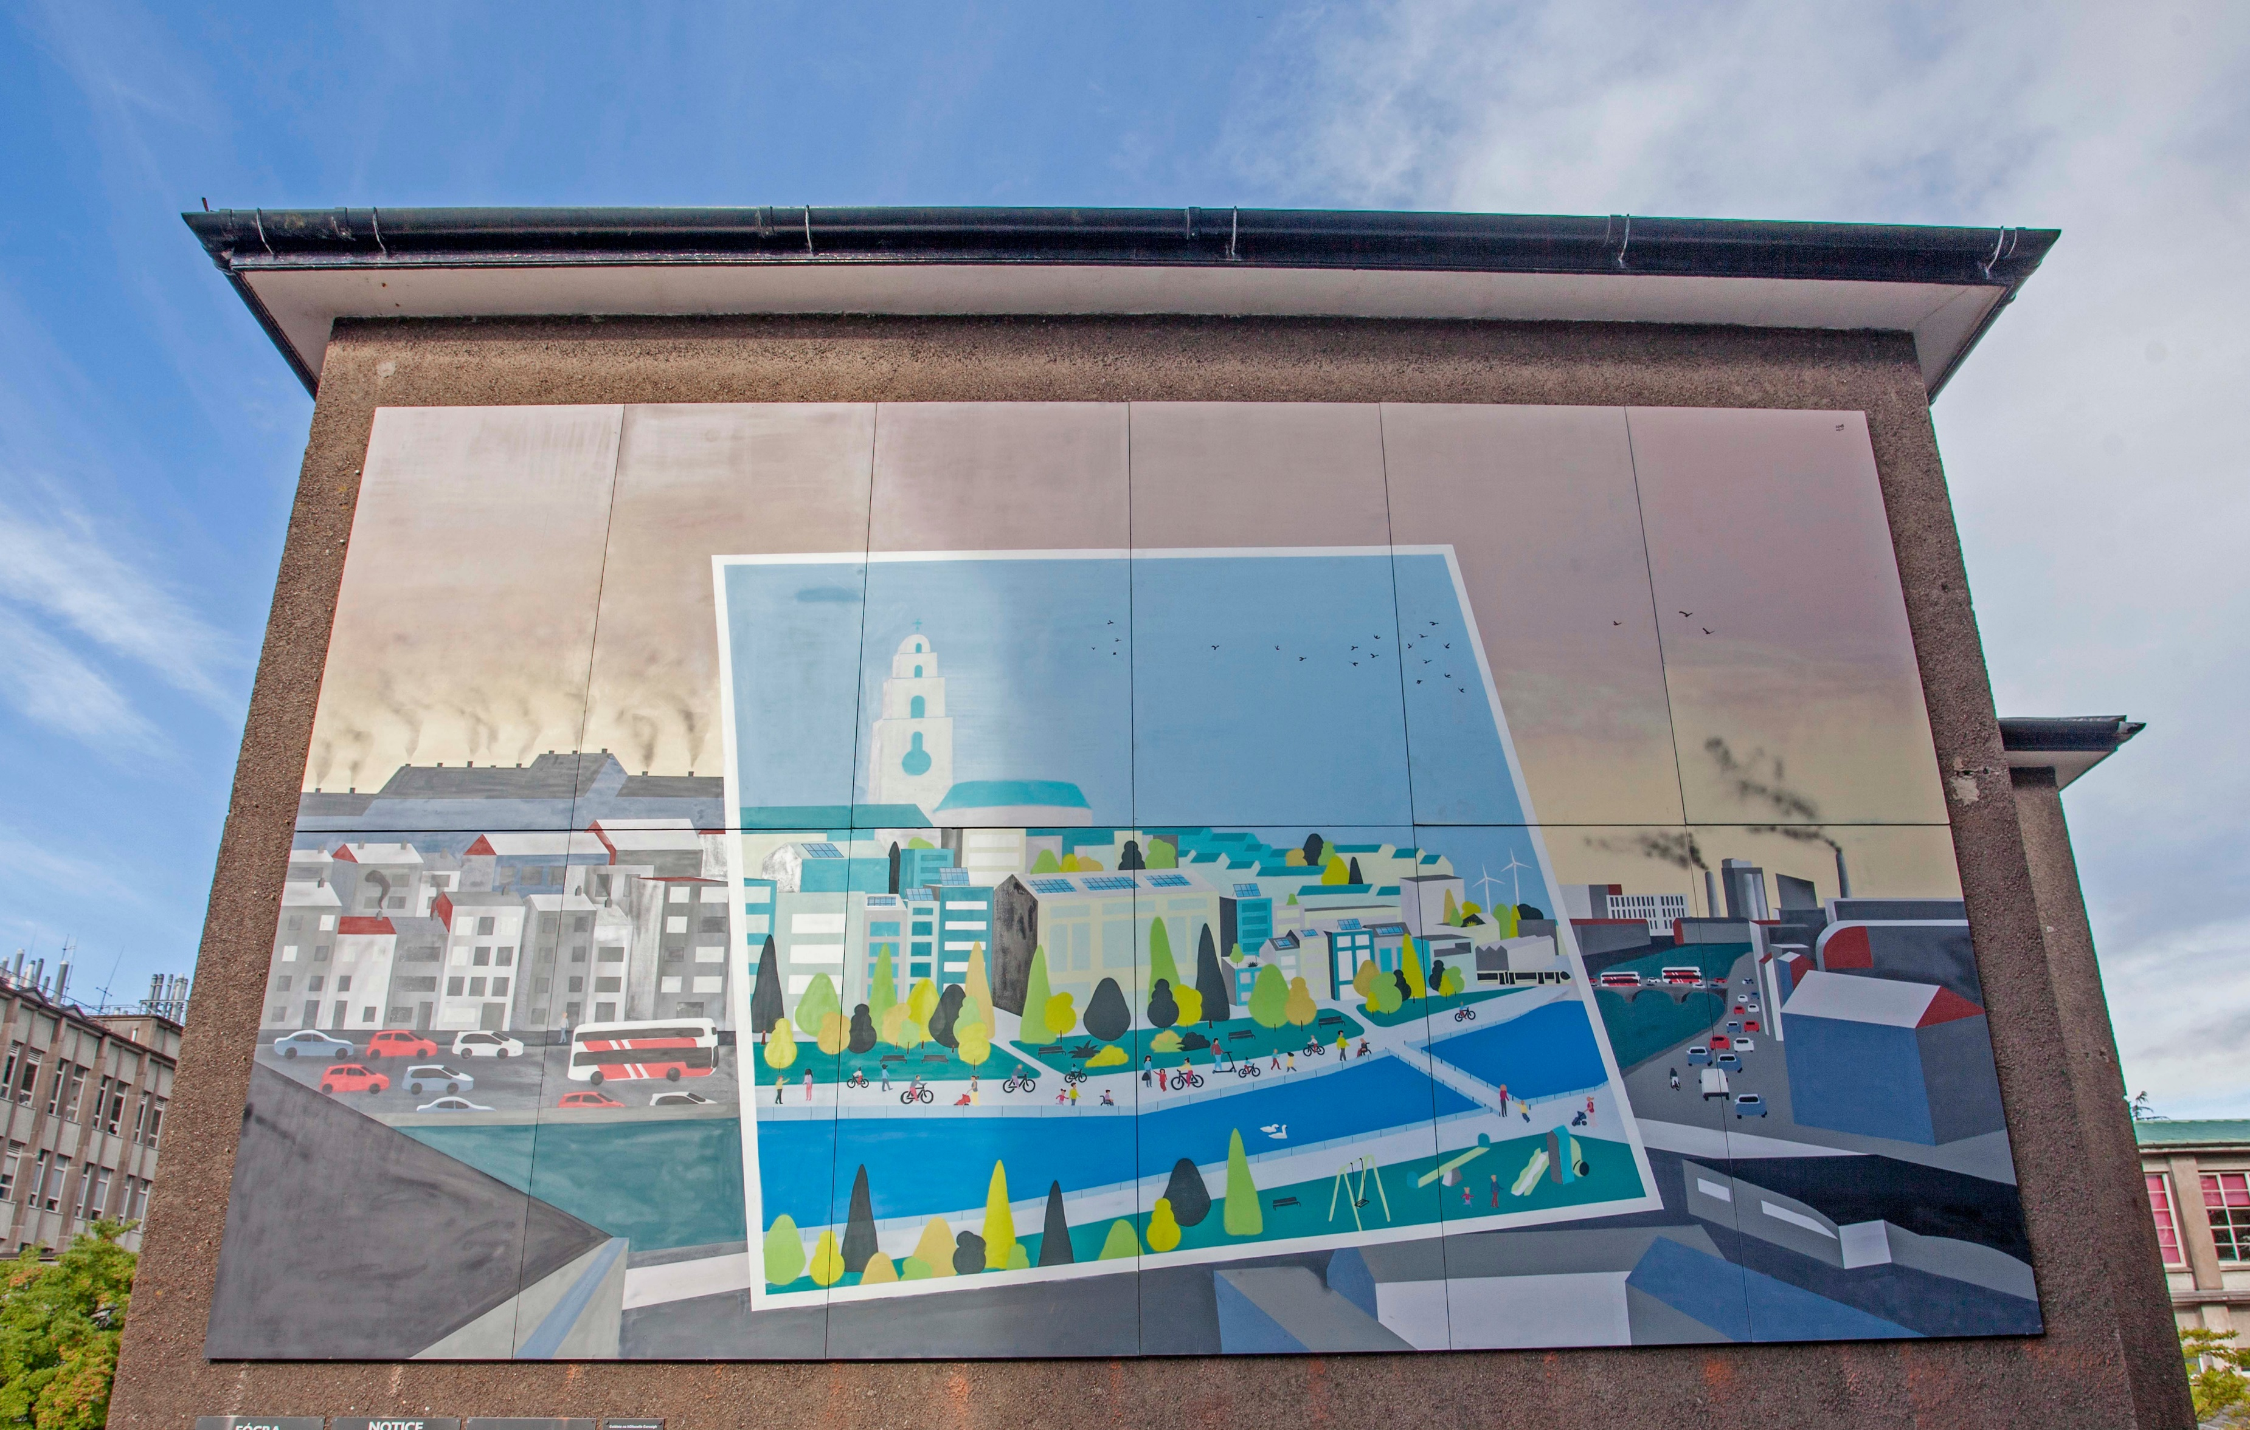
Closing slide
Notes:
[poliical leadership - RTÉ speech]
The speed of policy making has to increase
Delayism and distraction are now the most dangerous forces
A final ..
nglish, crisis was first used in a medical context, for the time in the development of a disease when a change indicates either recovery or death, that is, a turning-point.
I’m probably not alone in feeling that we collectively are at the cusp of many different turning point s. [for good and for bad].
The vision of a decent, healthy and sustainable life for humans on this planet is possible, and it is up to us to realise this vision.

