Slide 1

Research services
Est 2016

Slide 2
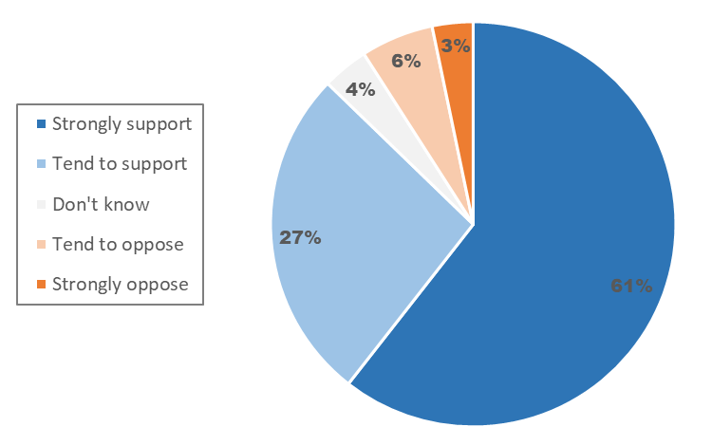
“Would you support or oppose an additional one off tax on energy companies and all companies that have seen larger profits due to energy prices”
Question 1: Windfall Tax
June 3/4th, Sample size 1,211

Slide 3
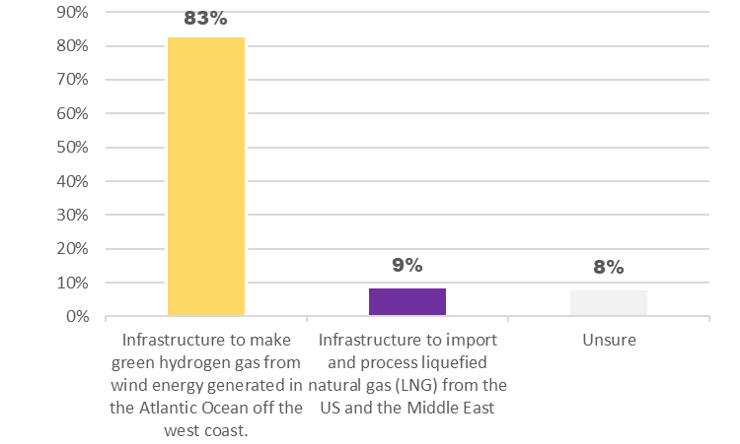
“Which of the following should Ireland prioritise for development to provide a long term alternative to Russian gas?”
Question 2: Renewable or LNG Infrastructure
June 3/4th, Sample size 1,211

Slide 4
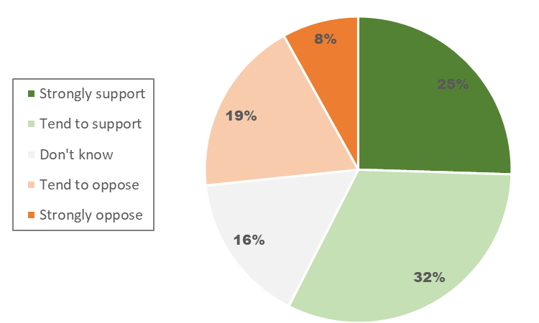
“An indefinite pause on connecting new data centres to the electricity grid”
Question 3i: Measures to deal with the energy crisis (ordered from lowest to highest support)
In response to the energy crisis/Russian invasion of Ukraine do you support or oppose the following measures
June 3/4th, Sample size 1,211

Slide 5
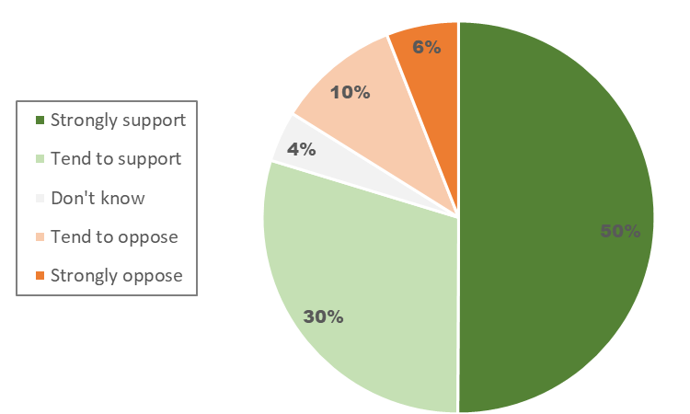
“The allocation of road space to make it safer for children to cycle and walk to school from less than 3km away”
Question 3ii: Measures to deal with the energy crisis
In response to the energy crisis/Russian invasion of Ukraine do you support or oppose the following measures
June 3/4th, Sample size 1,211

Slide 6
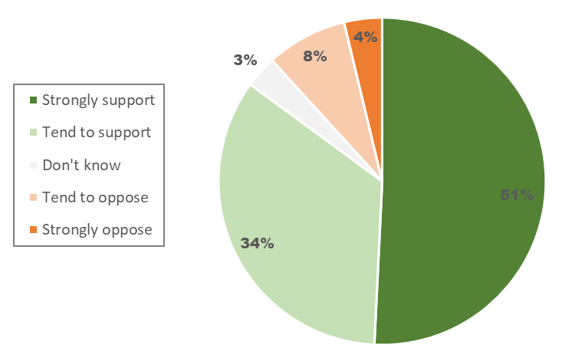
“Focusing government grants and support for home insulation and heat pumps on low income households/those most at risk of energy poverty”
Question 3iii: Measures to deal with the energy crisis
In response to the energy crisis/Russian invasion of Ukraine do you support or oppose the following measures
June 3/4th, Sample size 1,211

Slide 7
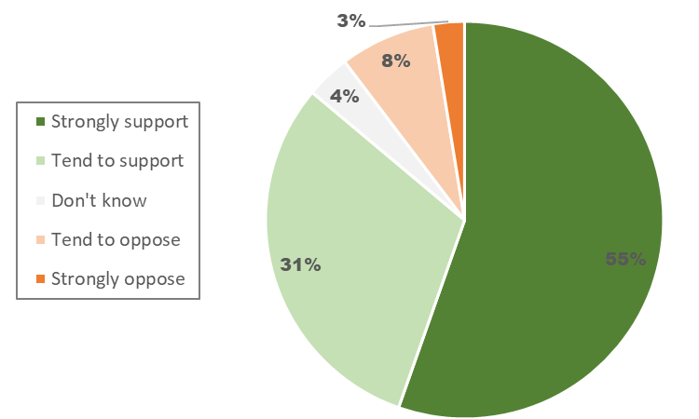
“Free school buses for all children who live more than 3km away from school”
Question 3iv: Measures to deal with the energy crisis
In response to the energy crisis/Russian invasion of Ukraine do you support or oppose the following measures
June 3/4th, Sample size 1,211

Slide 8
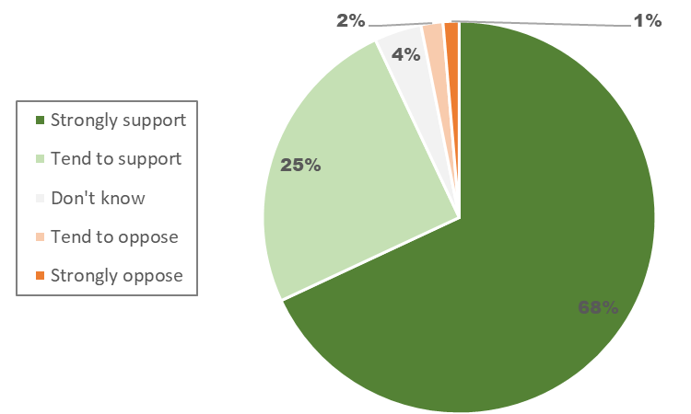
“Solar panels on every school in Ireland within 5 years”
Question 3v: Measures to deal with the energy crisis
In response to the energy crisis/Russian invasion of Ukraine do you support or oppose the following measures
June 3/4th, Sample size 1,211

Slide 9



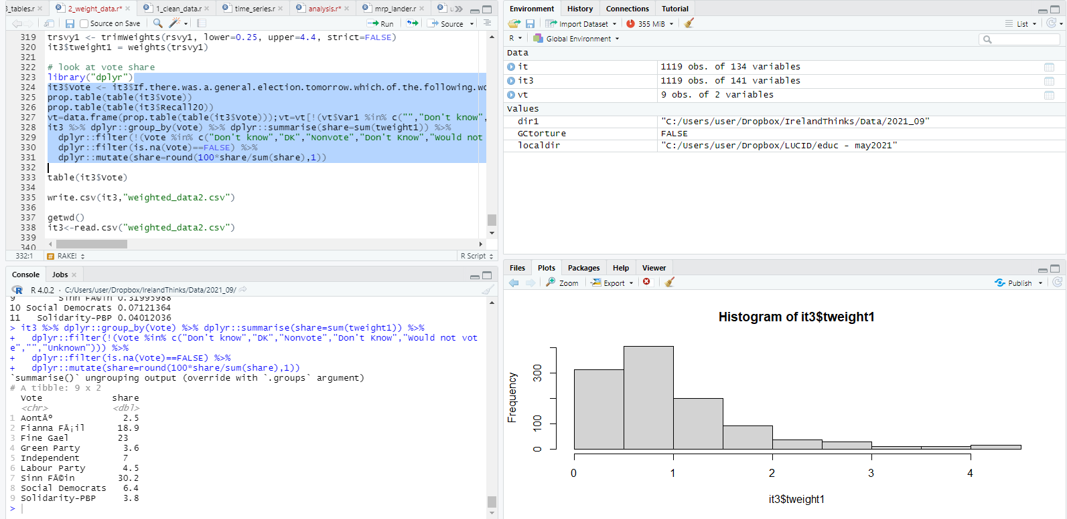
What is our polling methodology?
Stage 1: Where do your participants come from?
Using random digit dialling Ireland Thinks has built a panel of approximately 25,000 people, the equivalent of Thomond Park Stadium who are happy to participate in our monthly polls. This is continually topped up through advertisements targeting specific demographics as and when they are needed.
Stage 2: So, these are surely highly engaged people, how are they representative?
No. On our monthly polling weekends, our algorithm chooses 5,000 specific individuals to take part. They are chosen on the basis of their demographics and behaviours (age, gender, religious adherence, educational attainment, past voting behaviour, political interest etc.) to ensure that they are an exact replica of the census and within that, the most recent general election exit poll. They were initially asked this on polling day and have been re-asked and re-asked.
Note: This algorithm minimises design-effect error, meaning that cross-tabs tend to be more reliable.
Stage 3: So how do you contact them? And how do you know the right person is answering?
Participants are sent an SMS message with a unique URL to participate in the opinion poll. Over 90% of the population own a smartphone, far fewer are at-home during the day (for face to face), use land-lines, or respond to unsolicited calls, or emails. Any duplicated entries from the same URL are deleted as is the user. Respondents must also match the data we have on record for the respondent.
Note: Here we minimise social desirability bias and non-response bias.
Stage 4: How long does it take? How do I know they’re responding accurately?
We get over 1,000 responses within 3 hours, rising thereafter. The respondents experience is central to ensuring that we have quality responses. The polls are short, enjoyable and participants are rewarded by selecting the charity that we will donate to and results are published in a national newspaper. The responses are weighted to ensure that they are exactly representative of the population in terms of the same demographics above.
Note: Finally we minimise respondent error and sampling error.

Slide 10
Research services
Est 2016

